Slide 1
GUI Testing

Slide 2
Introduction
Screen common rules
Common specification rules
GUI processing specification
Applied Techniques
Boundary Value Analysis (BVA)
Equivalence partitioning (EP)
GUI check-list Example
Common GUI Defects/Errors/Failures

Slide 3
Overview
What’s GUI Testing?
GUI Testing is a software testing type that checks the Graphical User Interface (GUI) of the Software.
The purpose of GUI Testing is to ensure the functionalities of software application work as per specifications by checking screens and controls like menus, buttons, icons, etc.
GUI is what the user sees. A user does not see the source code. The interface is visible to the user. Especially the focus is on the design structure, images that they are working properly or not.
.
Why do GUI testing?
A normal User first observes the design and looks of the Application/Software, all we expect - it is easy to use, and GUI does exactly what it means.
If a user is not comfortable with the Interface or find Application complex to understand he would never be going to use that Application again or may cause misused the functionality.
That's why, GUI is a matter for concern, and proper testing should be carried out in order to make sure that GUI is free of Bugs.

Slide 4
List of GUI elements
Part types
Button Check Box Chart Combo Box
Common Dialog Custom Control Date Time Picker Dialog Tool Bar
Edit Box Form Group Box Icon
List Box List View Menu Message Box
Picture Progress Bar Push Button Radio Button
Shape Slide Bar Static Text Tab Control
Text Box Toggle Button Tool Bar NumericUpDown
Vscroll/ HScroll Bar
Arrangement of characters
Left-alignment
Right alignment
Center
Output condition type
Other screen
Data resource
Constant
Action
Left click
Right click
Double click
Focus out
Press and hold
Hover over
Dialog type
Error
Warning
Notification
Confirm
Character direction
Left>Right
Right>Left
Screen attribute
Main frame
System modal
Application modal
Modeless
Resize
Fixed
Changeable
Minimum/Maximize/Close buttons
Enabled
Disabled

Slide 5
Common specification rules
Display: Resolution e.g. FHD
OS: Windows theme
Framework: .Net Framework version
Language: EN/JP/etc.:
Design
Color scheme Window base color
Font Date format
The display area of buttons to be clicked
Window size Scroll bar
Screen size Margin width from the edge of the screen
Button arrangement Control arrangement
Control and control interval Maximum/Minimum control size
The display position of child screen (dialog box, message box)
Row numbers and width of list Ruled line of list box
Type definition Handling of half-width Katakana
Unification of parenthesis notation () Punctuation notation
Right-justified, left-justified of textbox Text wrapping setting
Base definition of button control

Slide 6
Usability
Reduction of number of operations Simultaneous display is possible Display the default value Filter setting by user Operation mistake prevention Highlighting Check location of the display screen During processing screen display Screen transitions when clicking buttons in dialog box The menu display when selecting list Tab key focus design policy Default button Header fixed when list control scrolling Default sort | Sort specification Changing column width of table Processing when pressing various keys List selection state preservation Menu display Minimum horizontal size of each split screen. Initial display of combo box Period default display Combo box Screen resizing policy About screen display position and screen size Maximum number of tabs displayed in the right pane of base screen The display of indefinite state Screen re-displaying during display

Slide 7
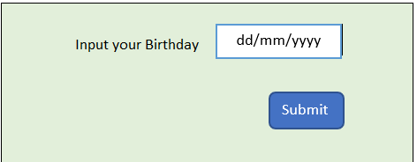
How to test each element of GUI?
For each part type e.g. , in order to text a text box that allow to input your birthday with format dd/mm/yyyy.
Exercise: use your knowledge, list out all possible cases that can use to test this spec ☺

Slide 8

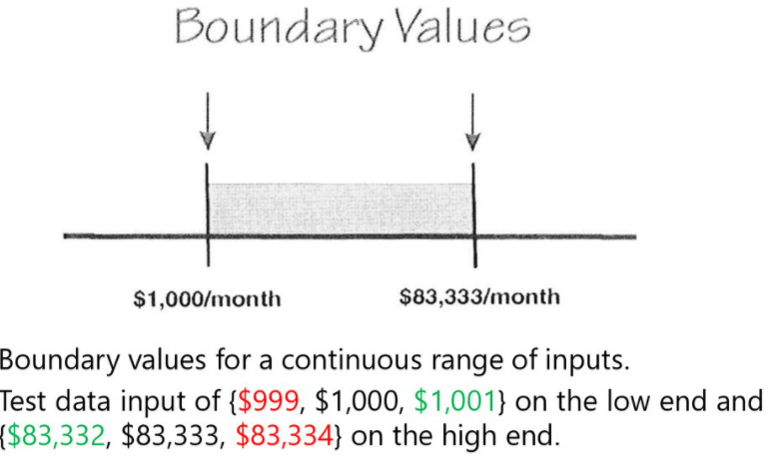
Most applied techniques – Boundary and Equivalence Partitioning
(1) What is limit value (boundary value) for each data type?
The target of next limit value test for each data type.
# | Data type | Example | Limit value
1 | Numerical data | short, int, long, float, double | Value
2 | Character string data | String | Length
3 | Date and time data | DateTime | Value
4 | File | File | Size, existence/non-existence, maximum number
(2) Setting method of test data
Test nearby value and limit value decided by spec.
Specifically, test below test data.
Lower limit-1
Lower limit
Upper limit
Upper limit+1
Example: Program spec is Input integer 0~99.
(3) Another example

Slide 9
Common Input check (test viewpoint)
Below are some test viewpoints that help us to build up common database for inputting checking.
Remember that don’t care how the application complex is, we just need to identify what input/output are, we can test any application.
Initial display
Confirm that layout of initial display perfectly matches with design document.
Layout
Alignment
Default focus
Initial data for any element such as fixed label, combo box, list, …
Etc
Confirm that activation/ deactivation of initial display perfectly matches with design document.
Example：・When user logs in as admin, "Edit" button is activated.
・When user logs in as member, "Edit" button is deactivated.
Confirm that display/ non-display state of corresponding item of initial display perfectly matches with design document. (Possibility of decentralization)
Especially, pay attention to below initial values for easily making mistake.
－Null character/data
－NULL/empty
－Half/full-width space/chars
－Lots of chars/data

Slide 10
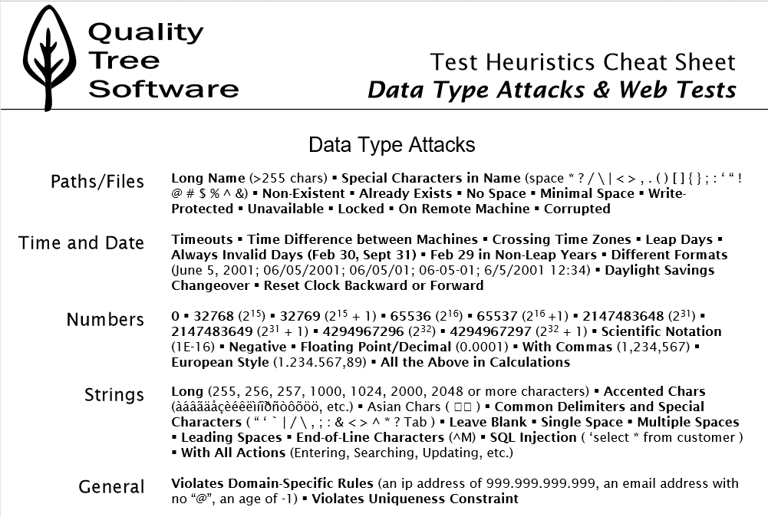

Slide 11
Common Errors/Failures
GUI testing is often performed first so most of GUI issues are detected. Below are some highlight sections
Layout
Wrong default or initial layout
Broken layout (e.g., layout is broken when changing screen resolution/size, zooming)
Overlapping (e.g.: the large data or lots of GUI elements)
Missing content/images
Spacing (unwanted space between list items, vertical spacing bug)
Alignment related issues e.g., left/right/center-aligned,
Background image/color
2. Content
Wrong Initial data
Wrong content e.g., spelling mistakes, get the content from wrong source/spec
Wrong alignment
Miss boundary checking e.g., with no data, with latest data
Wrong font size, font color
Abnormal data
4. Changing/navigation
Making any change on the screen/dialog -> refreshing it
Making any interruption on the screen/dialog -> refreshing it
Goback/gonext
3. Default value/setting
Default focus when invoked
Default data when invoked
Default alignment/setting/sort/filter/display when invoked

Slide 12
GUI Testing Checklist Example
When performing GUI testing, we should have a habit to create then update your own GUI checklist to detect common defects/failures quickly as well as avoid missing common GUI defects.
The following checklist is an example for you
Check all the GUI elements e.g., size, position, width, length, and acceptance of characters or numbers. For instance, you must be able to provide inputs to the input fields.
Check you can execute the intended functionality of the application using the GUI
Check Error Messages are displayed correctly
Check for Clear demarcation of different sections on screen
Check Font used in an application is readable
Check the alignment of the text is proper
Check the Color of the font and warning messages is aesthetically pleasing
Check that the images have good clarity
Check that the images are properly aligned
Check the positioning of GUI elements for different screen resolution.
Check the display in case of no data to too much data.
etc

Slide 13
Conclusion
Do you love the beauty? ☺
Sure, we are.
So, the application is same
When testing GUI, let keep in your mind that “We all love the beauty, our application needs to be beautiful too” ☺

Slide 14
Questions & answers
Let me know if you have any questions, thanks.

Slide 15
Resources
List the resources you used for your research:
Source #1
Source #2
Source #3

